Slide 1
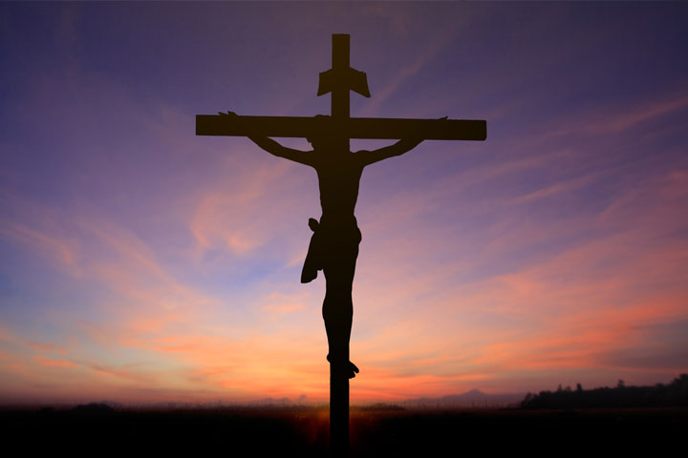
The Meaning of Holy Week

Slide 2
Opening Prayer

Slide 3
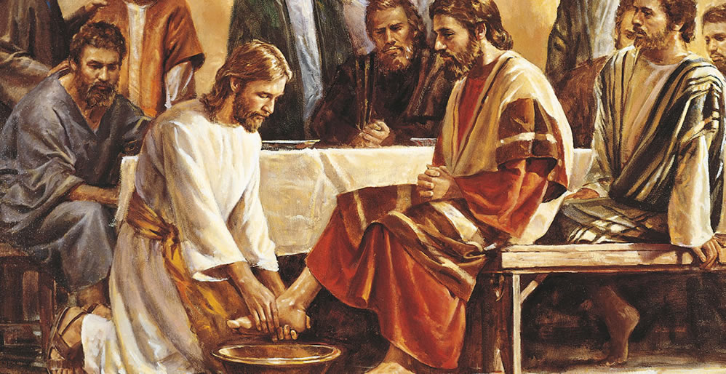
Opening Scripture
John 13:1-15

Slide 4
The Catechism of the Catholic Church
Holy Week: The week preceding Easter, beginning with Palm (Passion) Sunday, called the “Great Week” in the liturgies of the Eastern Churches. It marks the Church’s annual celebration of the events of Christ’s Passion, death, and Resurrection, culminating in the Paschal Mystery. (CCC Index)

Slide 5
The Catechism of the Catholic Church
…Easter is not simply one feast among others, but the “Feast of feasts,” the “Solemnity of solemnities,” just as the Eucharist is the “Sacrament of sacraments” (the Great Sacrament). St. Athanasius calls Easter “the Great Sunday” and the Eastern Churches call Holy Week “the Great Week.” The mystery of the Resurrection, in which Christ crushed death, permeates with its powerful energy our old time, until all is subjected to him. (CCC 1169)

Slide 6
Symbolon Video The Paschal Mystery The Mystery of Christ’s Death and Resurrection

Slide 8
Palm Sunday
In biblical times, the palm tree was considered a kingly tree because of its lofty height and majestic appearance, making it a symbol of royalty and victory.
The Jewish people carried palm branches in their processions on festive holy days.
Roman soldiers carried palms in victory parades.
The people of Jerusalem greeted Jesus in the spirit of joy and triumph usually accorded victorious kings and armies.

Slide 9
Palm Sunday
Our palm branches signify a joyful victory, the ultimate victory of Jesus in his Easter triumph over death and sin.
The palm branches are a reminder of the victory that awaits each of us as followers of Jesus.
While we must endure many sufferings in our own lives, Jesus taught us that this is the way to a victorious resurrection and everlasting life.
The Two Gospels of Psalm Sunday illustrate our fickle human nature.

Slide 10
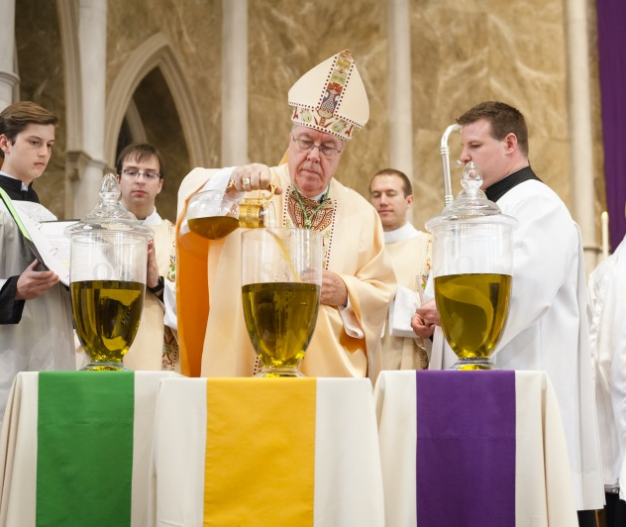
Chrism Mass – During Holy Week
Bishop pours the fragrance balsam into a container of olive oil as part of the rite of consecrating Sacred Chrism

Slide 11
Chrism Mass – During Holy Week
Held at the Diocesan Cathedral
Nominally on Thursday morning
In our diocese held on Wednesday morning
Clergy and people gather with Bishop
Priests renew their promises to priestly service
Bishop asks the people to pray for priests

Slide 12
Chrism Mass – During Holy Week
Bishop Blesses:
Oil of the Sick (OI) - For the healing of body, mind, and soul.
Oil of the Catechumens (OC or OS) - For the anointing of those preparing for Baptism.
Sacred Chrism (SC) Olive Oil mixed with balsam - Used to anoint infants after Baptism, those to be confirmed, Bishops and Priests at their Ordination, and altars and churches at the time of their dedication.
Notes:
OI and OC are “blest” while SC is ”blest and sanctified.” See https://www.usccb.org/prayer-and-worship/sacraments-and-sacramentals/sacramentals-blessings/blessing-of-oils-and-consecration-of-chrism

Slide 13
The Easter Triduum
The summit of the Liturgical Year is the Easter Triduum—from the evening of Holy Thursday to the evening of Easter Sunday. Though chronologically three days, they are liturgically one day unfolding for us the unity of Christ's Paschal Mystery.
The celebration of the Triduum marks the end of Lent
Liturgical services during the Triduum are:
Mass of the Lord's Supper (Thursday night)
Good Friday of the Lord's Passion (Good Friday)
Mass of the Resurrection of the Lord

Slide 14
Holy Thursday Mass of the Lord’s Supper
Holy Thursday Mass of the Lord’s Supper celebrates the institution of the Eucharist as the true body and blood of Jesus Christ and the institution of the priesthood.
During the Last Supper, Jesus offers himself as the Passover sacrifice, the sacrificial lamb.
He took bread and wine, gave thanks, and told his Apostles (the first priests) “do this in memory of me.”
Christ also bids farewell to his followers and prophesizes that one of them will betray him and hand him over to the Roman soldiers.

Slide 15
Holy Thursday Mass of the Lord’s Supper
During supper Jesus, master and teacher (and also God), humbled himself by taking on the duty of a slave by washing the feet of his disciples.
He told his disciples to use his washing of their feet as a “model to follow, so that as I have done for you, you should also do.”
The Washing of the Feet rite we perform at Mass (Mandatum) is an imitation of Christ’s washing the feet of the Apostles and an expression of the self-gift signified by this gesture of service.
Notes:
https://www.vatican.va/roman_curia/congregations/ccdds/documents/rc_con_ccdds_doc_20160106_commento-decreto-lavanda-piedi_en.html

Slide 16
Holy Thursday Mass of the Lord’s Supper
At the conclusion of the Mass, the altar is stripped and the faithful are invited to continue Adoration of the Blessed Sacrament throughout the night, just as the disciples were invited to stay up with the Lord during His agony in the garden before His betrayal by Judas.
After Holy Thursday, no Mass will be celebrated again in the Church until the Easter Vigil celebrates and proclaims the Resurrection of Jesus Christ.

Slide 17
Good Friday
Good Friday is the second day of the Easter Triduum and the day that Catholics and other Christians throughout the world commemorate the crucifixion of Jesus.
From the earliest days, Good Friday has been kept as an “aliturgical” day, that is one on which we do not celebrate Mass.
The Eucharist received on Good Friday was consecrated a day earlier at the Holy Thursday liturgy.

Slide 18
Good Friday
The Good Friday liturgy has three parts:
Liturgy of the Word
Veneration of the Cross
Holy Communion
At the end of the Good Friday service the ministers and assembly depart in silence.
Good Friday is also a day of fasting and abstinence from meat.

Slide 19
Holy Saturday
The Church is silent.
The altars are bare.
The tabernacle is empty.
We wait in silence at the tomb for the Lord’s Resurrection.
We prepare for the Easter sacraments by prayer, reflection, and optional fasting.

Slide 20
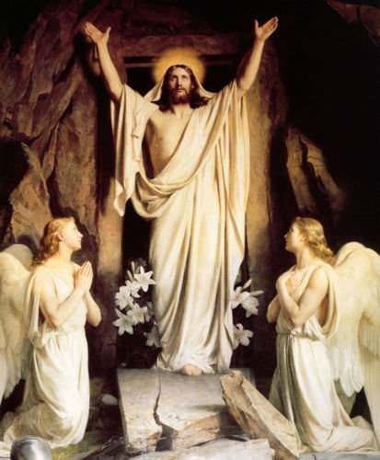
Easter Sunday of the Resurrection of the Lord

Slide 21
Evidence of the Resurrection
1 Corinthians 15 (Read and Meditate this week)
St. Paul references the 500+ witnesses of the resurrected Christ and says that if it had not in fact happened, then “We are false witnesses to God.” (1 Cor 15:15)
“[I]f Christ has not been raised, your faith is vain; you are still in your sins. Then those who have fallen asleep in Christ have perished. If for this life only we have hoped in Christ, we are the most pitiable people of all.” (1 Cor 15:17-19)

Slide 22
Evidence of the Resurrection
The Apostles were shunned, beaten, run out of town, and most of them were martyred for their belief in the Resurrection of Jesus.
The fact that so many witnesses of Christ’s Resurrection chose to die rather than simply deny its truth to save their lives was a great motivating factor for those who converted to Christianity.
It still is.

Slide 23
Why the Resurrection Matters
As St. Paul indicates, the Resurrection validates Jesus’ teachings as coming from the Father.
The fact that His prophesy of his own resurrection came to pass gives credibility to all of His teachings – especially the Christian doctrine of the resurrection of the dead.

Slide 24
Why the Resurrection Matters
This belief in the Resurrection has been confirmed and reiterated time and time again by the Catholic Church and other Christians.
Christ’s rising from the dead gives Christians reason to believe that they too will experience an afterlife, and therefore, a reason to live out Christian values.

Slide 25
What the Resurrection Means
Neither God the Father, who offered his only begotten son, nor Jesus who sacrificed his very life, has held back anything to open the gate and give us the opportunity to enter the Kingdom of Heaven.
Jesus offering of himself as a sacrifice is a perfect act of love.
His great sacrifice is also an example of how to love one another.

Slide 26
What the Resurrection Means
The call to “love one another; even as I have loved you” has a radical meaning in light of the crucifixion.
Because of it, love is equated with self-sacrifice, the idea of putting other’s needs before our own.
This shift in the definition of love changed the world.

Slide 27
Questions and Discussion

Slide 28
Holy Week Schedule
Sunday, April 2nd
Palm Sunday
Holy Thursday, April 6th
7:00 PM: Mass of the Lord’s Supper
Need volunteers for the washing of feet ritual, presentation of the oils and presentation of the offertory gifts.
Good Friday, April 7th
2:00 PM: Live Stations of the Cross with Holy Spirit Youth
2:45 PM: Chaplet of Divine Mercy
3:00 PM: Reading of the Passion, Holy Communion and Veneration of the Cross
Holy Saturday, April 8th
Easter Vigil practice at 10:00 AM in the Church.
Everyone and their Sponsors must be present.
Easter Vigil at 8:30 PM. Will last approximately 3 hours.
Arrive at Church at least 15 minutes early!
Seating arrangements – We need to know how many family members will be attending. They can sit with you and your sponsor in the reserved pews.

Slide 29
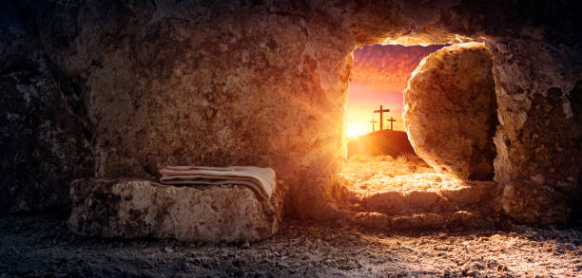
No Class on April 9th Easter Sunday

Slide 30
Closing Prayer
Good and gracious Lord,
We love you. We praise you. We adore you.
You have led each one of us along the faith journey that leads to you, and now we entrust ourselves fully to your rich love and the graces we will receive this week.
You are Lord and Creator, the one who formed each life in this room. Shine your love upon us so that we may know you more deeply and more personally than we have ever known. Continue to bless us in our journey towards you. Amen!

